Slide 1
Broken Profile Dynamic Programming

Slide 2
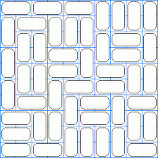
Problem
In how many ways can you cover an n×m board with dominos?

Slide 3
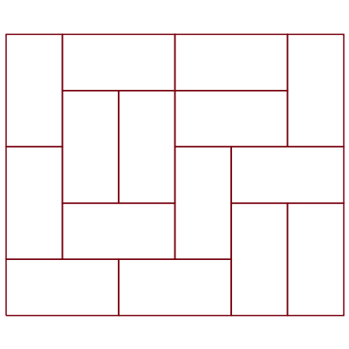
Constraints - Easy problem
1<=N<=1,000,000
M = 1

Slide 4
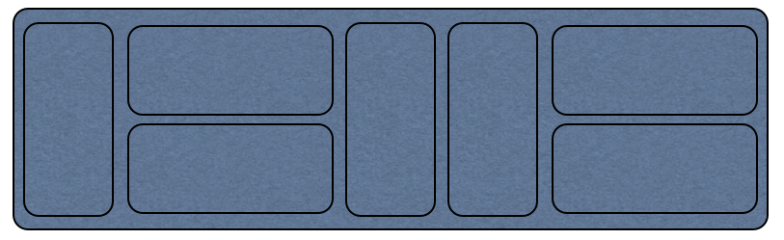
Constraints - Medium Problem
1<=N<=1,000,000
M=2

Slide 5
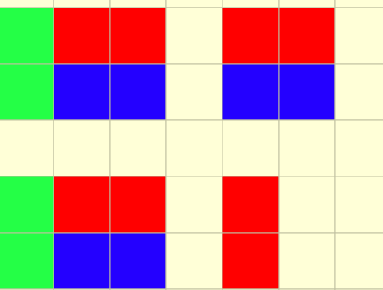
Medium Problem - Solution
The end of any given tiling is one of the 2 patterns on the right

Slide 6

Medium Problem - Solution
The end of any given tiling is one of the 2 patterns on the right

Slide 7
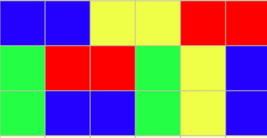

Constraints - Medium+ Problem
1<=N<=1,000,000
M=3

Slide 8
Constraints - Hard problem
1<=N<=1,000,000
1<=M <=5

Slide 9
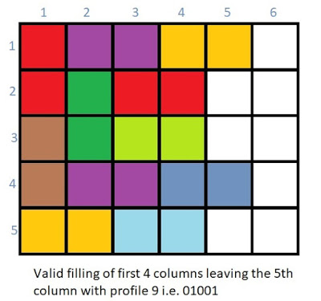
Profile Considerations
DP[i][P] = number of ways to completely fill the first i rows and have profile P in the next one.

Slide 10
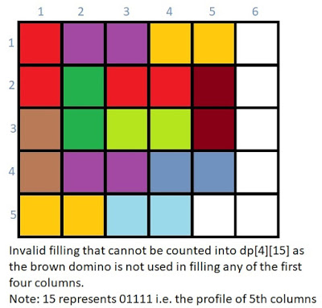
Profile Considerations
DP[i][P] = number of ways to completely fill the first i rows and have profile P in the next one, with no full dominos in row i+1.

Slide 11
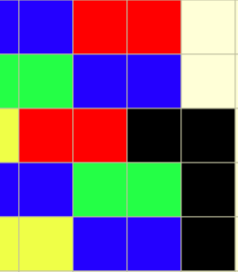
Recurrence
Can we go from DP[i][P] to DP[i-1][Q]:
f(P,Q) = 1
p = 1 + 2 + 8 + 16 = 27
q = 1 + 2 + 4 = 7

Slide 12
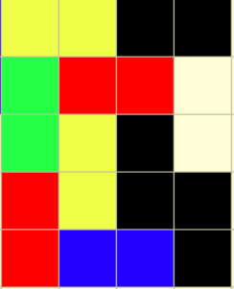
Recurrence
Can we go from DP[i][P] to DP[i-1][Q]:
f(P,Q) = 0

Slide 13
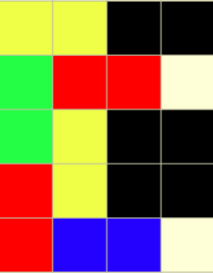
Recurrence
Can we go from DP[i][P] to DP[i-1][Q]:
f(P,Q) = 1

Slide 14
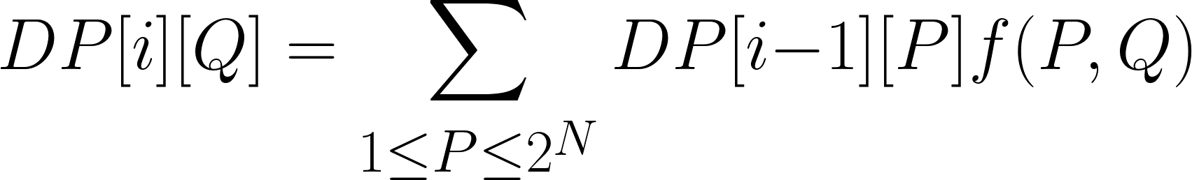
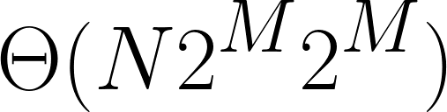
Recurrence

Slide 15
Constraints - Very Hard problem
1<=N<=1,000,000
1<=M <=10

Slide 16
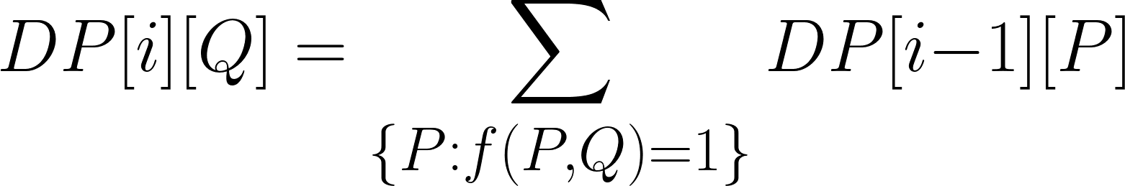
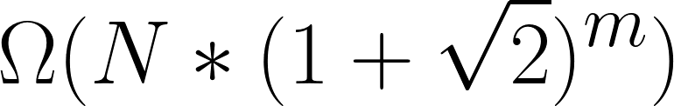
Recurrence

Slide 17
https://gist.github.com/Alex7Li/2dab3baa08895bbb5702fabac4e3e2b5

Slide 18
https://coderevilbuggy.blogspot.com/2018/05/broken-profile-dynamic-programming.html

Slide 19
Constraints - Very Very Hard problem
1<=N<=BIG
1<=M <=BIG

Slide 20

Solution - Wikipedia
Notes:
This is an integer O: Computing it accurately isn’t that easy thou

Slide 21
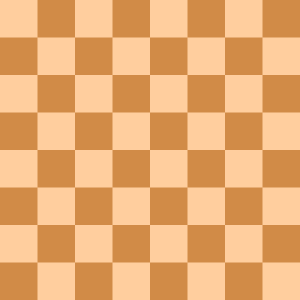

Fun - Mutilated Chessboard (Without 2 corners)
Is there at least 1 way?

Slide 22
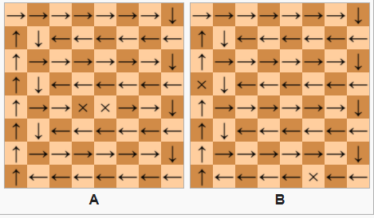
Fun - Mutilated Chessboard (2 Different colors)
Is there at least 1 way?

Slide 23
Fun - Mutilated Chessboard
Is there at least 1 way?

Slide 24
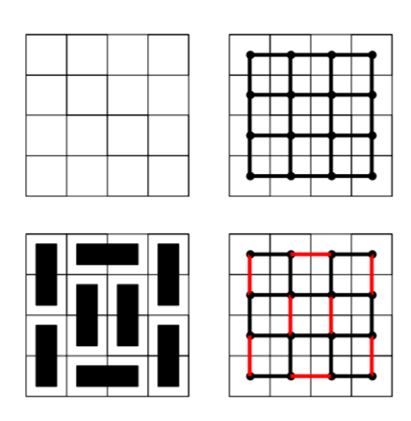
Graph REphrasing

Slide 25
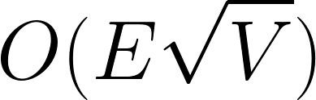
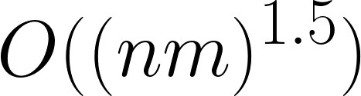
Graph REphrasing
A valid grid coloring corresponds to a perfect matching in this bipartite graph.
Finding a perfect matching in a graph can be done with the Hopcroft-Karp algorithm in

Slide 26
Graph REphrasing
This idea is the first step in getting us a polynomial time algorithm to count dominos on an n by m grid!
http://www.math.cmu.edu/~bwsulliv/domino-tilings.pdf

Slide 27
Questions?

Slide 28
K Thx Bye

